Slide 1
Database System
Darshan university

Slide 2

Introduction
In today’s fast-paced world, data is generated from every digital computing device, handheld phone, workstation, server, and so on. This valuable information generated by millions of computing devices, helps private, public, and professional enterprises store, monitor, and analyze data for different purposes. What is Database Systems? These are systems that cater to such data services.

Slide 3
Outline
The Need for Databases
Data Models
Relational Databases
Database Design
Storage Manager
Query Processing
Transaction Manager

Slide 4
Database Management System (DBMS)
DBMS contains information about a particular enterprise
Collection of interrelated data
Set of programs to access the data
An environment that is both convenient and efficient to use
Database Applications:
Banking: transactions
Airlines: reservations, schedules
Universities: registration, grades
Sales: customers, products, purchases
Online retailers: order tracking, customized recommendations
Manufacturing: production, inventory, orders, supply chain
Human resources: employee records, salaries, tax deductions
Databases can be very large.
Databases touch all aspects of our lives

Slide 5
Drawbacks of using file systems to store data
Data redundancy and inconsistency
Multiple file formats, duplication of information in different files
Difficulty in accessing data
Need to write a new program to carry out each new task
Data isolation
Multiple files and formats
Integrity problems
Integrity constraints (e.g., account balance > 0) become “buried” in program code rather than being stated explicitly
Hard to add new constraints or change existing ones

Slide 6
Drawbacks of using file systems to store data (Cont.)
Atomicity of updates
Failures may leave database in an inconsistent state with partial updates carried out
Example: Transfer of funds from one account to another should either complete or not happen at all
Concurrent access by multiple users
Concurrent access needed for performance
Uncontrolled concurrent accesses can lead to inconsistencies
Example: Two people reading a balance (say 100) and updating it by withdrawing money (say 50 each) at the same time
Security problems
Hard to provide user access to some, but not all, data

Slide 7
Levels of Abstraction
Physical level: describes how a record (e.g., instructor) is stored.
Logical level: describes data stored in database, and the relationships among the data.
type instructor = record
ID : string; name : string; dept_name : string; salary : integer;
end;
View level: application programs hide details of data types. Views can also hide information (such as an employee’s salary) for security purposes.

Slide 8
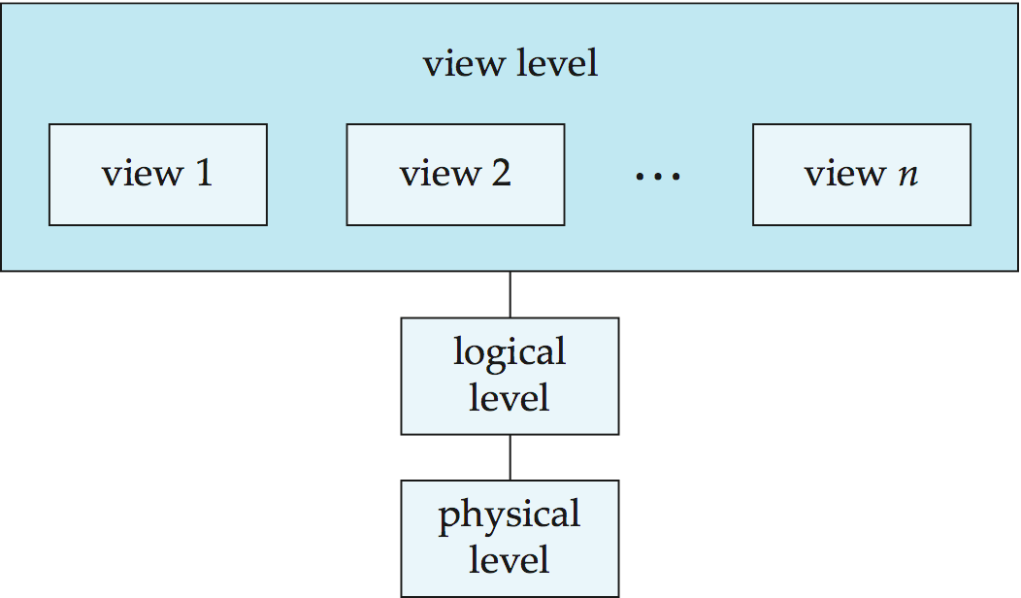
View of Data
An architecture for a database system

Slide 9
SQL
The most widely used commercial language
SQL is NOT a Turing machine equivalent language
SQL is NOT a Turing machine equivalent language
To be able to compute complex functions SQL is usually embedded in some higher-level language
Application programs generally access databases through one of
Language extensions to allow embedded SQL
Application program interface (e.g., ODBC/JDBC) which allow SQL queries to be sent to a database

Slide 10
Database Design
The process of designing the general structure of the database:
Logical Design – Deciding on the database schema. Database design requires that we find a “good” collection of relation schemas.
Business decision – What attributes should we record in the database?
Computer Science decision – What relation schemas should we have and how should the attributes be distributed among the various relation schemas?
Physical Design – Deciding on the physical layout of the database

Slide 11
Thank You

